Slide 1
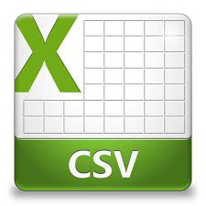

CHAPTER - VI CSV FILES

Slide 2

Unit I
Class XII
COMPUTATIONAL THINKING AND PROGRAMMING
(70 Theory + 50 Practical)
Prepared by
Praveen M Jigajinni
DCSc & Engg, PGDCA,ADCA,MCA.MSc(IT),Mtech(IT),MPhil (Comp. Sci)
Department of Computer Science, Sainik School Amaravathinagar
Cell No: 9431453730
Courtesy CBSE

Slide 3
INTRODUCTION
When you export data from Website, the files can be delivered in the following formats
1
CSV - Comma Separated Values
PSV - Pipe Separated Values
2
TSV - Tab Separated Values
3

Slide 4

1
CSV - COMMA SEPARATED VALUES
A CSV(Comma Separated Values) is a plain-text file format used to store tabular data such as a spreadsheet or a database. It essentially stores a tabular data which comprises of numbers and text into plain text.

Slide 5
2
PSV - PIPE SEPARATED VALUES
When you export contact data and survey data from the Gateway eNews letter and Website systems, the files will be delivered in a "pipe delimited" format. This means that the various columns are separated by a pipe character.

Slide 6
3
TSV - TAB SEPARATED VALUES
A text file format that uses tab characters as separators between fields. The tab delimited format stores information from a database or spreadsheet in the format of a tabular structure. Both Microsoft and Google allow the user to convert a spreadsheet into tab delimited format.

Slide 7

CSV FILES
What is a CSV File?

Slide 8
CSV FILES
What is a CSV File?
A CSV(Comma Separated Values) is a plain-text file format used to store tabular data such as a spreadsheet or a database. It essentially stores a tabular data which comprises of numbers and text into plain text.

Slide 9


CSV FILES
CSV Files generally open into Excel and nearly all the databases have different specific tools to allow the import of the same.
csv
Tablular data is represented by comma seperated values

Slide 10

CSV FILES
STRUCTURE OF CSV FILE WITH EXAMPLE

Slide 11
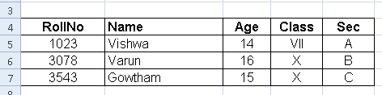
CSV FILES
For Example
Tabular data is represented by comma separated values

Slide 12

STRUCTURE OF CSV FILE
RollNo,Name,Age,Class,Sec
1023,Vishwa,14,VII,A
3078,Varun,16,X,B
3543,Gowtham,15,X,C
Every line of the file is called a record. And each record consists of fields that are separated by commas which are also known as “delimiter” which is the default delimiter, others include pipe(|), semicolon(;). Given below is a structure of a Normal CSV File separated by a comma

Slide 13

CSV FILE
Why is CSV File Format Used?

Slide 14
CSV FILE
Why is CSV File Format Used?
CSV is a plain-text file which makes it easier for data interchange and also easier to import onto spreadsheet or database storage.
For example: You might want to export the data of a certain statistical analysis to CSV file and then import it to the spreadsheet for further analysis. Overall it makes users working experience very easy programmatically. Any language supporting a text file or string manipulation like Python can work with CSV files directly.

Slide 15

CSV FILES
Advantages
ADVANTAGES OF CSV FILES

Slide 16




CSV FILES - ADVANTAGES
ADVANTAGE
01
ADVANTAGE
02
ADVANTAGE
03
ADVANTAGE
04
CSV is human readable and easy to edit manually
CSV is processed by almost all existing applications
CSV is faster to handle
CSV is smaller in size

Slide 17
CSV FILES - ADVANTAGES
ADVANTAGE
05
ADVANTAGE
06
ADVANTAGE
07
ADVANTAGE
08
CSV is considered to be standard format
CSV provides straightforward information schema
CSV is simple to implement and parse
CSV is easy to generate

Slide 18

CSV FILES
DISADVANTAGES
DISADVANTAGES OF CSV FILES

Slide 19


CSV FILES - DISADVANTAGES
01
02
03
CSV allows to move most basic data only. Complex configurations cannot be imported and exported this way
There is no distinction between text and numeric values
No standard way to represent binary data

Slide 20
CSV FILES - DISADVANTAGES
04
05
06
Poor support of special characters
No standard way to represent control characters
Lack of universal standard

Slide 21
CSV FILE TYPES
CSV
Files

Slide 22
CSV FILE TYPES
CSV
Files
CSV (Comma delimited)
1
2
CSV UTF-8 (Comma delimited)
3
CSV (Macintosh)
4
CSV (MS-DOS)

Slide 23
CSV (COMMA DELIMITED)
1
A comma-separated values file is a delimited text file that uses a comma to separate values. Each line of the file is a data record. Each record consists of one or more fields, separated by commas.
Exporting to CSV uses a default encoding of Unicode (UTF-16le)

Slide 24
2
CSV UTF-8 (COMMA DELIMITED)
UTF-8 (Unicode Transformation Format -8 ) encoding, also referred to as "Unicode - UTF8" UTF-8 encoded CSV files will work well with Accompa (Accompa is a leading cloud-based requirements management software that helps you capture, track and manage requirements for your products & projects).

Slide 25
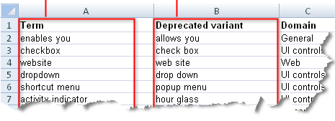
2
CSV UTF-8 (COMMA DELIMITED)
just English characters, or also contain non-English characters such as é, ç, ü

Slide 26
3
CSV (MACINTOSH)
CSV (Macintosh) .csv. Saves a workbook as a comma-delimited text file for use on the Macintosh operating system, and ensures that tab characters, line breaks, and other characters are interpreted correctly.

Slide 27
4
CSV (MS-DOS)
CSV (DOS).csv. Saves a workbook as a comma-delimited text file for use on the Macintosh operating system, and ensures that tab characters, line breaks, and other characters are interpreted correctly.

Slide 28
PYTHON CSV MODULE
CSV
Files

Slide 29
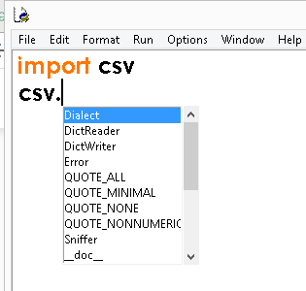
PYTHON CSV MODULE
Python uses a CSV package which is a part of the standard library, so you need not install it.

Slide 30
PYTHON CSV MODULE
Python CSV package contains following functions:
Ser | Functions | Description
1 | csv.field_size_limit | It returns the maximum field size
2 | csv.get_dialect | Fetches the dialect associated with name
3 | csv.list_dialects | Displays all the registered dialects
4 | csv.reader | Read data from csv file

Slide 31
PYTHON CSV MODULE
Python CSV package contains following functions:
Ser | Functions | Description
5 | csv.register_dialect | Dialect associated with a name
6 | csv.writer | Writes data to a csv file
7 | csv.unregister_dialect | It deletes the dialect associated with the name dialect registry
8 | csv.QUOTE_ALL | Quotes everything irrespective of the type

Slide 32
PYTHON CSV MODULE
Python CSV package contains following functions:
Ser | Functions | Description
9 | csv.QUOTE_MINIMAL | Quotes special character field
10 | csv.QUOTE_NONNUMERIC | Quotes fields that are not numeral
11 | csv.QUOTE_NONE | Doesn’t quote anything in output

Slide 33
CSV FILE OPERATIONS IN PYTHON
CSV
Files

Slide 34
CSV FILE OPERATIONS IN PYTHON
You can perform several manipulations once a CSV file is loaded. I am going to show the read and write operations on a CSV file in Python
READING AND WRITING FILES
The csv module is used for reading and writing files. It mainly provides following classes and functions:

Slide 35
READING AND WRITING FILES
1
reader() METHOD
2
writer() METHOD
DictReader() METHOD
3
DictWriter() METHOD
4

Slide 36
READING AND WRITING FILES
reader() METHOD
1

Slide 37
reader() METHOD
1
The reader() function takes a file object and returns a _csv.reader object that can be used to iterate over the contents of a CSV file. The syntax of reader() function is as follows:
Syntax: reader(fileobj [, dialect='excel' [, **fmtparam] ]) -> _csv.reader

Slide 38
reader() METHOD
1
Argument | Description
fileobj | (required) It refers to the file object
dialect | (optional) Dialect refers to the different ways of formatting the CSV document. By default, the csv module uses the same format as Microsoft Excel.
fmtparam | (optional) It refers to the set of keyword arguments to customize the dialect.

Slide 39
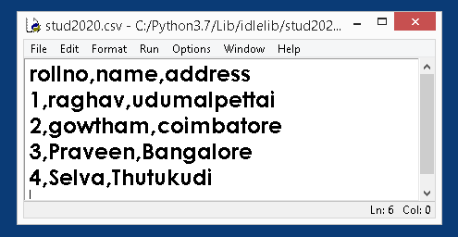
reader() METHOD
1
1
Let's say we have following CSV file:
stud2020.csv

Slide 40
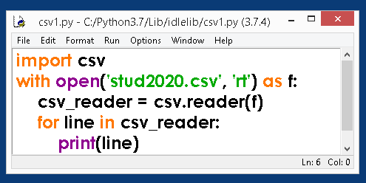
reader() METHOD
1

Slide 41
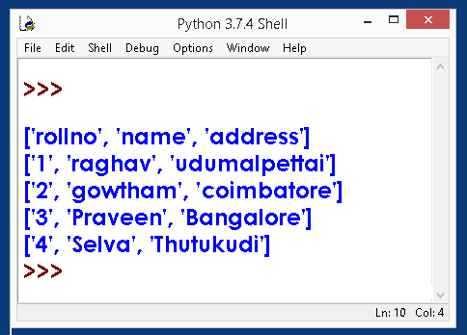
reader() METHOD
1
OUT PUT

Slide 42
reader() METHOD
1
PRINTING SELECTED FIELDS

Slide 43
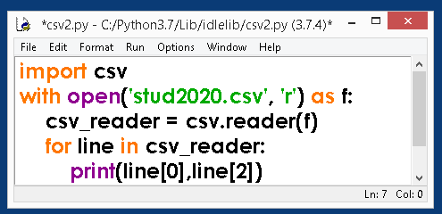
reader() METHOD
1
PRINTING SELECTED FIELDS

Slide 44
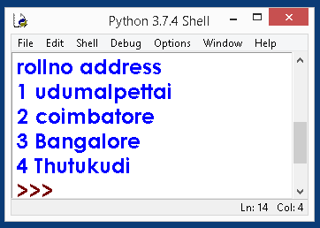
reader() METHOD
1
PRINTING SELECTED FIELDS
OUT PUT

Slide 45
writer() METHOD
2
OUT PUT

Slide 46
writer() METHOD
2
OUT PUT
To write data to a CSV file we use the writer() function. It accepts the same argument as the reader() function but returns a writer object (i.e _csv.writer):
Syntax: writer(fileobj [, dialect='excel' [, **fmtparam] ]) -> csv_writer

Slide 47
writer() METHOD
2
OUT PUT
ARGUMENT | DESCRIPTION
fileobj | (required) It refers to the file object
dialect | (optional) Dialect refers to the different ways of formatting the CSV document. By default, the csv module uses the same format as Microsoft Excel. We will discuss dialect in detail later in this post.
fmtparam | (optional) Formatting parameters, work same as the reader()'s function.

Slide 48
2
OUT PUT
THE WRITER INSTANCE METHODS

Slide 49
THE WRITER INSTANCE METHODS
The writer instance provides the following two methods to write data:
Method | Description
writerow(row) | Writes a single row of data and returns the number of characters written. The row must be a sequence of strings and number.
writerows(rows) | Writes multiple rows of data and returns None. The rows must be a sequence.

Slide 50
2
THE WRITER INSTANCE METHODS
THE writerow(row) METHOD

Slide 51
THE WRITER INSTANCE METHODS
THE writerow(row) METHOD
Writes a single row of data and returns the number of characters written. The row must be a sequence of strings and number.

Slide 52
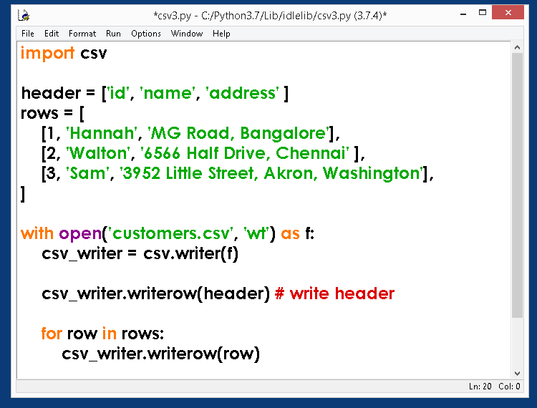
THE writerow(row) METHOD

Slide 53
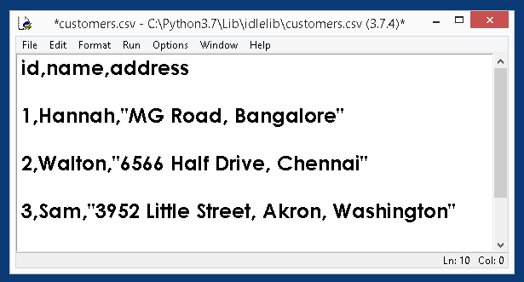
THE writerow(row) METHOD
OUT PUT

Slide 54
2
THE WRITER INSTANCE METHODS
THE writerows(rows) METHOD

Slide 55
THE WRITER INSTANCE METHODS
THE writerows(rows) METHOD
Writes multiple rows of data and returns None. The rows must be a sequence.

Slide 56
2
THE WRITER INSTANCE METHODS
THE writerows(rows) METHOD
THE writerows(rows) EXAMPLE

Slide 57
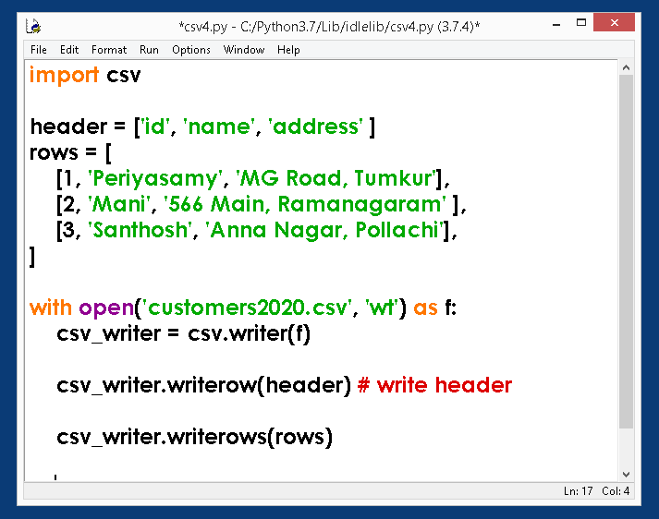
THE writerows(rows) EXAMPLE

Slide 58
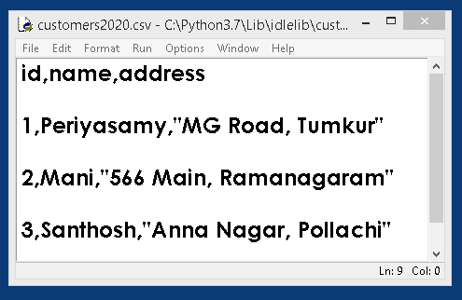
THE writerows(rows) EXAMPLE
OUT PUT

Slide 59
DictReader() METHOD
3
DictWriter() METHOD
4
These two methods are beyond the scope of syllabus.

Slide 60


